Slide 1
BECOME: Biliterate Equitable Committed Observant Multicultural Educator A PATHWAY FOR CHANGE
Fernando Rodríguez-Valls, Ph.D.
Lisa Winstead, Ph.D.
Armando Garza, Ph.D.
California State University, Fullerton

Slide 2
BILITERACY PK-16
BILITERACY
LONG
TERM
COMMITMENT
BILITERATE BICULUTURAL
WORK FORCE
COMMUNITY

Slide 3
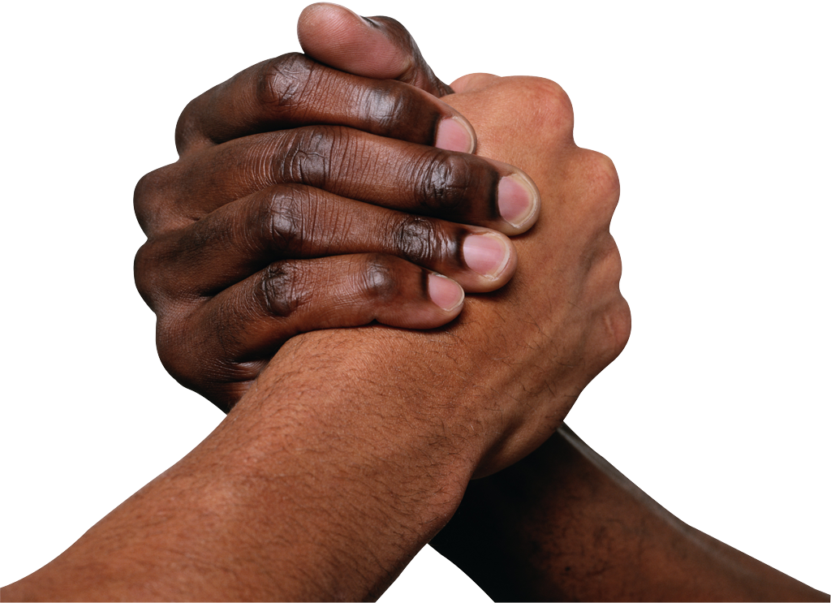
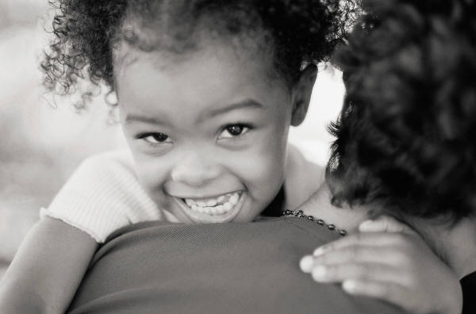

BECOME
Commitment
Sensitivity
Preparation

Slide 4
A committed, engaged pedagogy fuels the engine of an inclusive classroom
The concept of the committed and engaged pedagogy visualizes every student as an active participant in the language development/acquisition processes (hooks, 2010)
The new classroom in which languages coexist and students learn a second language is a classroom that functions as a learning cooperative (Gavilán Bouzas and Alario Sánchez, 2014)
We have to help the student grow and develop as a global citizen, prepared to enrich their culture and language with new cultures and new languages (García, 2009; Grosjean & Li, 2013).

Slide 5
Inclusive Education
With a partner create an acronym that explains how you define inclusive education
I
N
C
L
U
S
I
V
E

Slide 6
Culturally and linguistically responsive methodology
Which language(s) should be taught in the classroom?
In the inclusive classroom, the teacher teaches the target language and in the target language, using the language as a tool through which the student analyzes in a critical way the linguistic aspects that connect and differentiate himself/herself from their classmates.
The student has the right to have their cultural and linguistic identity not only valued but also utilized to contextualize and enrich the learning processes (Nieto, 2013).
[activities and strategies] focus on and respond to the positive and unique cultural [linguistic] experiences that children and their families contribute to the school community…
educators need to strive for excellence and must be able to design meaningful [activities] and stimulating academic environments”
Biliteracy in the classroom, the WE space

Slide 7
Language(s) Proficiency(ies)
Teaching in two languages calls for teachers who know how to communicate in personal and intellectual ways.
The way teachers use the classroom discourse has a direct impact when constructing a participatory and inclusive classroom environment.
Teaching in two languages is an expression of equity, which goal is to critically analyze the role languages and their registers play within different contexts.
Ultimately, the goal is to read the word and the worlds with biliterate, critical eyes.

Slide 8
Bilingual Authorization
Language Emphasis | Engaged Methodology | Cultural Responsive Practice | Language Proficiency
Spanish | Methods and Inquiry for Bilingual Teachers EDSC 446 | Culture and Education of Latino Students EDSC 541 | Oral and written exam at CSUF
Mandarin, Korean and Vietnamese | Methods and Inquiry for Bilingual Teachers EDSC 446 | Culture and Education of … Students EDSC 541 | CSET LOTE III in the target language

Slide 9
Why Spanish Bilingual Authorization in Multiple Subjects (Elementary Ed)?
Opportunity to become part of a community and networking with other Spanish bilingual educators who desire to teach in dual immersion or bilingual programs
Full time classes during the day during initial weeks as well as fieldwork, then…
Gaining semester to year-long bilingual student teaching experiences in dual immersion/bilingual classrooms
Bilingual Authorization courses may need to be taken in summer

Slide 10
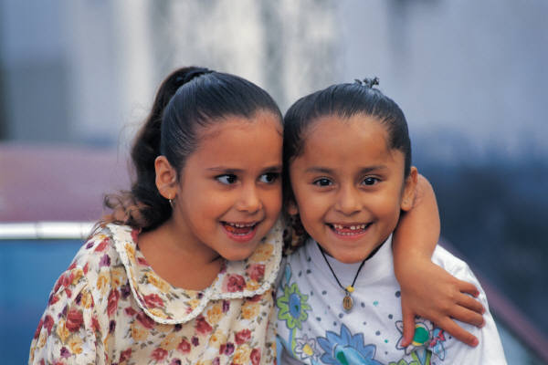
Spanish Bilingual Authorization in the Dept. of Elementary and Bilingual Ed.
Generally two semesters
Two additional courses beyond the Multiple Subject Credential
EDEL/EDSC 446
EDEL/EDSC 541
Student teaching in dual immersion classroom for up to 2 semesters
Building and support of ongoing development of Spanish literacy and instruction

Slide 11
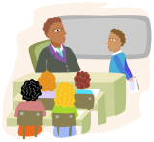
To Obtain a Spanish Bilingual Authorization in Dept. of Elementary & Bilingual Education
Bachelor’s Degree or
Completion of GE requirements with no more than 6 units remaining in your major
Admission into Multiple Subject Credential Program

Slide 12
Gracias / Thank you / 謝謝 / شكرا Salamat / 고맙습니다 / cảm ơn bạn
Fernando Rodríguez-Valls- COE Bilingual Authorization Program Coordinator: frodriguez-valls@fullerton.edu
Lisa Winstead- Spanish Bilingual Authorization Coordinator, EDEL
lwinstead@fullerton.edu
Armando Garza- Spanish Bilingual Authorization Outreach, EDEL
agarza@fullerton.edu
“No one is born fully-formed: it is through self-experience in the world that we become what we are” Paolo Freire

